Slide 1
E-Learning Assistant
NLP Term Project
Jinping Shi
Yi-Hshin Chen

Slide 2
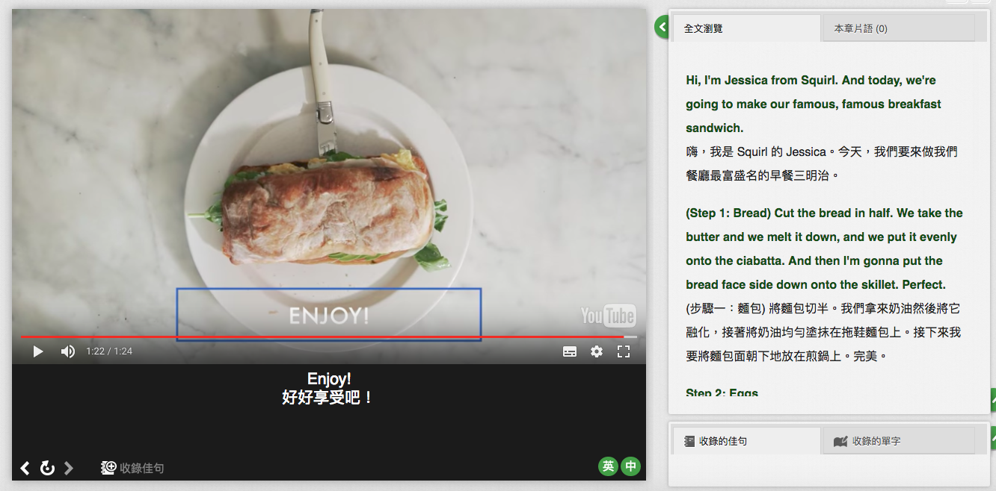

?
?
?
?
?
Ask questions
wait for answers
?
?
?
?
?
?
?
?
Goal:
Classify students’ questions into English grammar categories
By doing this, we can:
Know the weakness of each student
Provide study recommendation for students
Track study route for each student

Slide 3
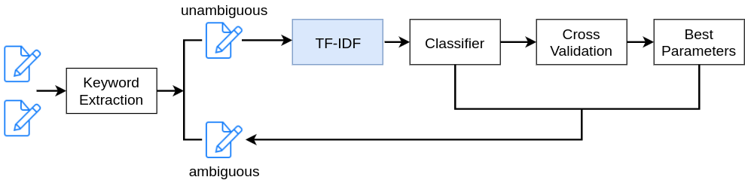
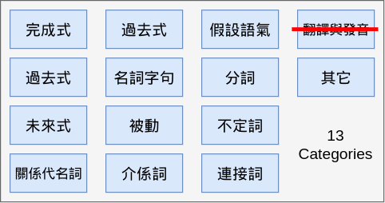
questions
answers
為什麼這裏要用兩個that呢？
that wasn’t the way to create a good brand是名詞字句嗎？
It’s that you’re trying為何有兩個主詞？

